Slide 1

A Full-Stack Application using Angular and Node.js
NATIONAL INSTITUTE OF TECHNOLOGY PATNA
Ashok Rajpath, Mahendru Patna(Bihar)
Department of Computer Science and Engineering
Group no 21
Contribution by-
Anshu Kumari 2006039

Slide 2
INTRODUCTION-
A Todo List application developed using Angular for the front end and Node.js for the back end.
MongoDB is used for data storage.

Slide 3
Overview-
Angular: A front-end framework used to build a dynamic and responsive user interface.
Node.js: A back-end runtime environment that allows JavaScript to be run on the server-side.
Express.js: A web application framework for Node.js to build APIs.
MongoDB: A NoSQL database to store the todo items.

Slide 4
Methodology-
Objective: Develop the application iteratively.
Activities: Set up the environment, implement front-end (Angular), back-end (Node.js, Express.js),
and database (MongoDB) integration.
Deliverables: Front-end and Back-end Source Code, Functional Application.

Slide 5
Project Goals-
List of Goals:
Build a responsive and interactive user interface.
Implement CRUD operations (Create, Read, Update, Delete).
Store data in a NoSQL database.
Provide a seamless user experience.

Slide 6
Tools Used to make this project happen
Front-end: Angular
Back-end: Node.js, Express.js
Database: MongoDB
Tools: Visual Studio Code, Postman, Git

Slide 7
Architecture-
Diagram: Show a high-level architecture diagram.
Front-end: Angular application
Back-end: Node.js server with Express.js
Database: MongoDB

Slide 8
Front-end Overview-
Angular:
Components
Services
Modules
Features:
Dynamic UI
HTTP Client for API calls
Two-way data binding

Slide 9
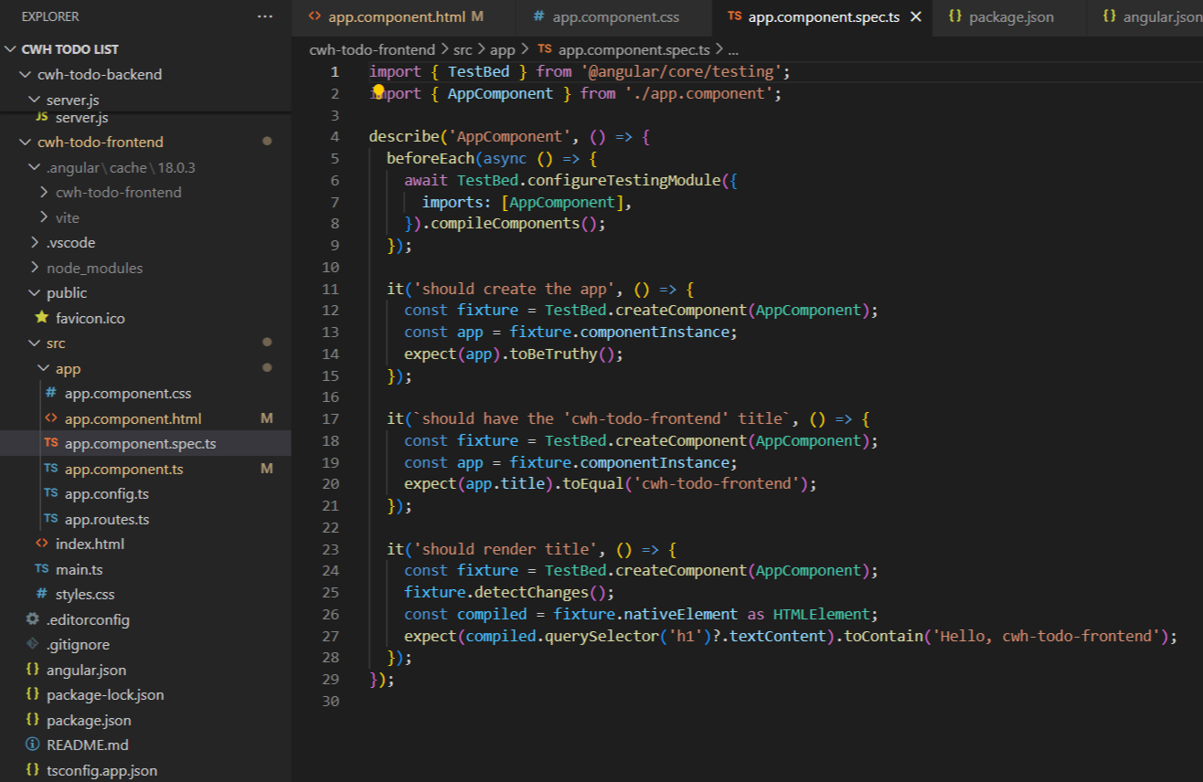
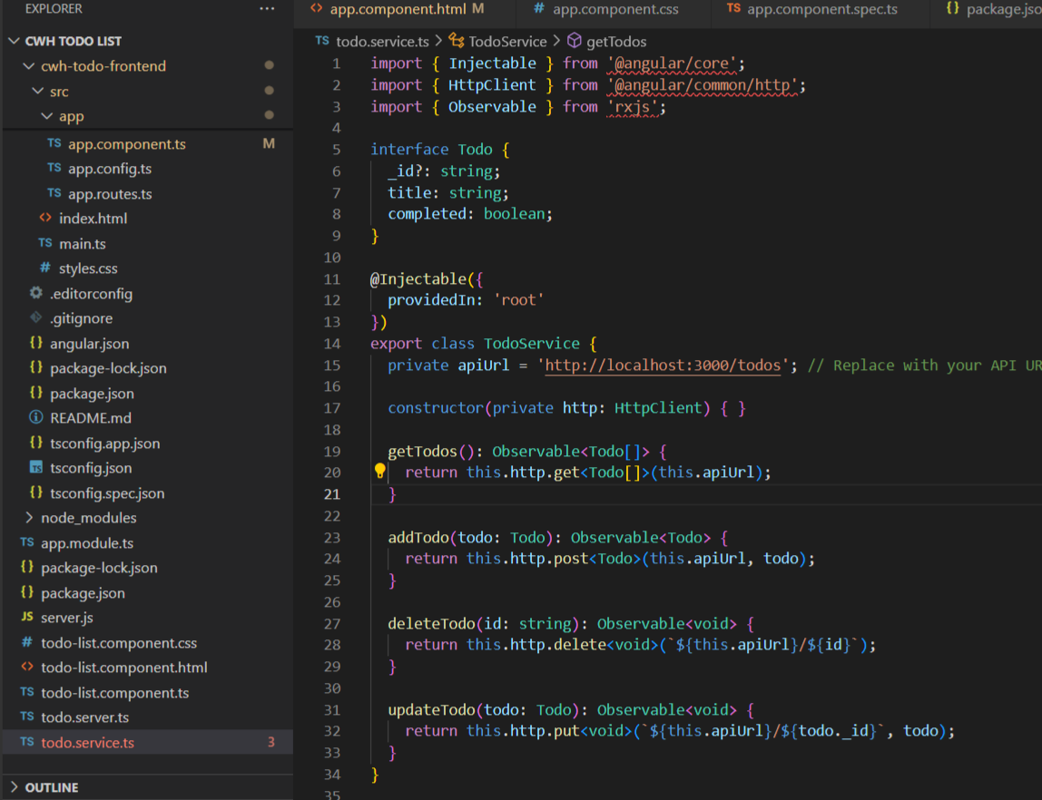
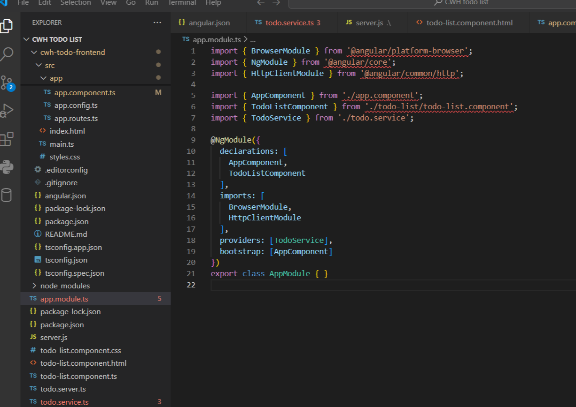
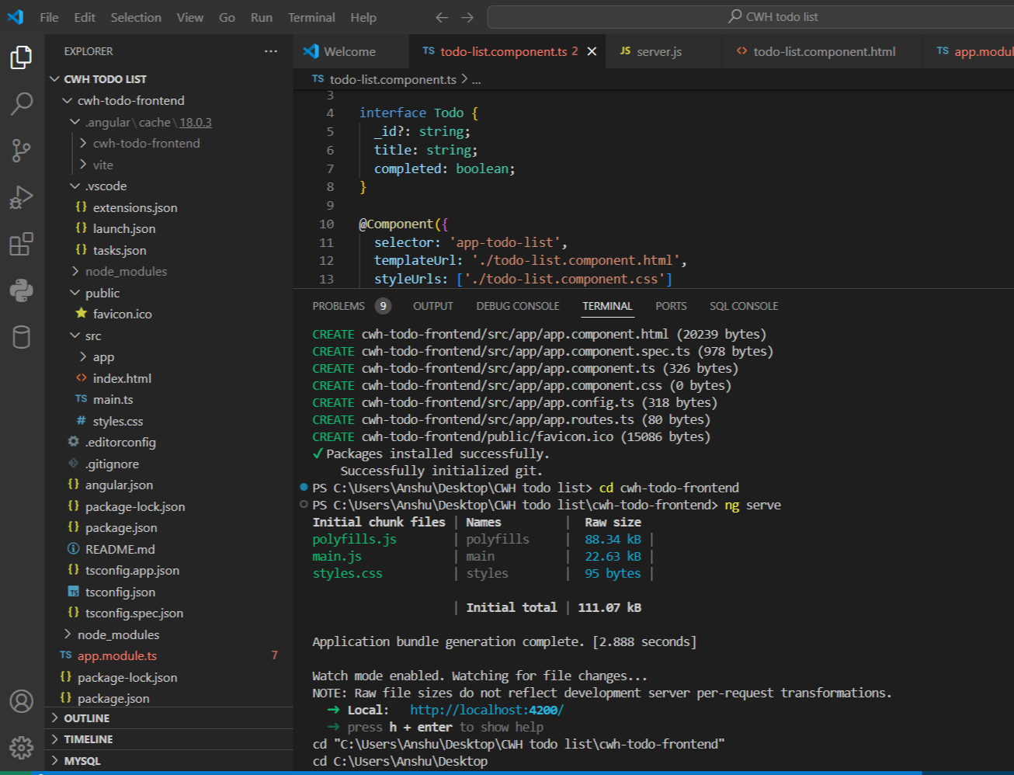
Front-end Overview
Component
Service
Module

Slide 10
Back-end Overview-
Node.js and Express.js:
Server setup
Middleware usage (body-parser, cors)
Routes:
GET, POST, PUT, DELETE endpoints
Database:
MongoDB connection and schema definition

Slide 11
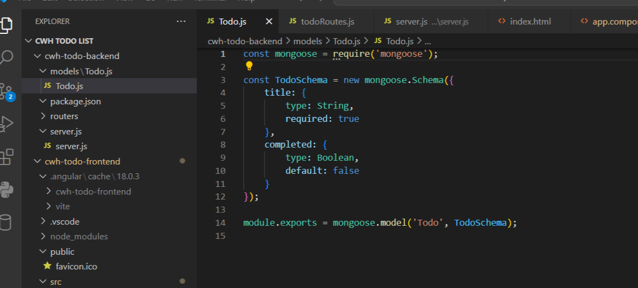
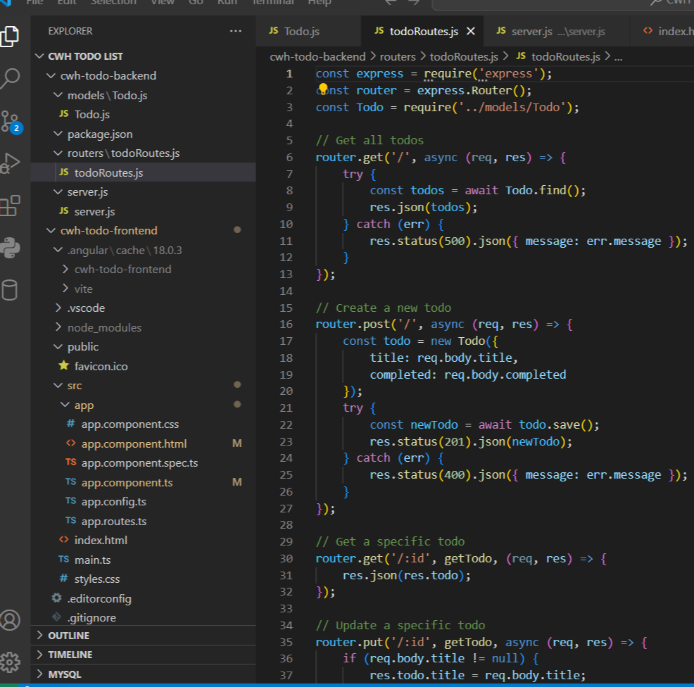
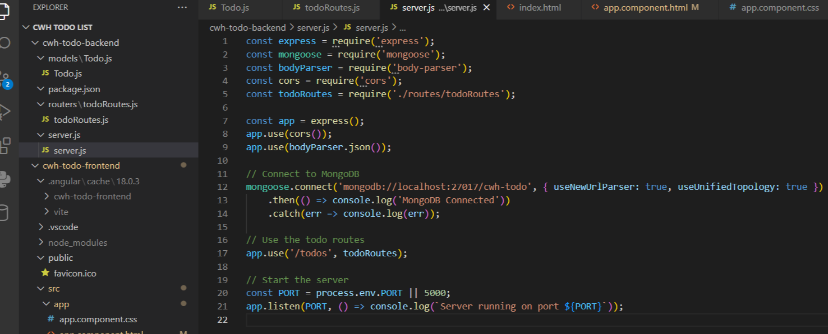
Back-end Overview-
Todo.js
Router.js
Server.js

Slide 12
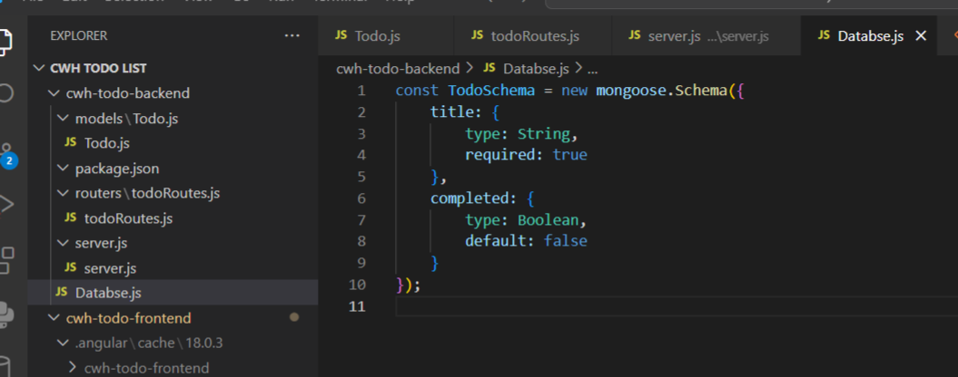
Database Schema
Todo Schema:

Slide 13
Implementation Details - Front-end
Service: Todo. service.ts-
Methods for API calls (getTodos, addTodo, deleteTodo, updateTodo)
Component: todo-list.component.ts
Logic for displaying and interacting with todos

Slide 14
Implementation Details - Back-end
Routes: routes/todoRoutes.js
CRUD operations
Server Setup: server.js
Middleware configuration
MongoDB connection
Route definitions

Slide 15
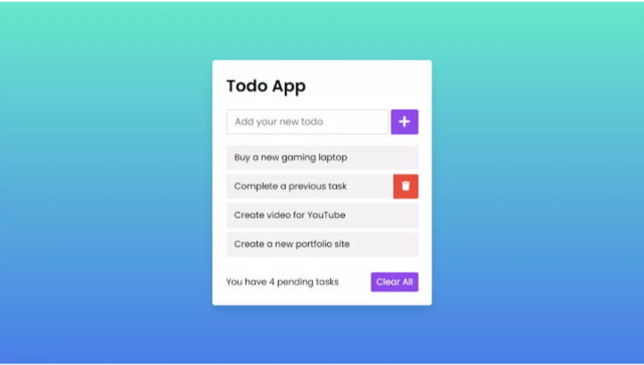
RESULT-

Slide 16
Conclusion-
Successfully built a full-stack Todo List application.
Learned about Angular, Node.js, and MongoDB.

Slide 17
Future Research-
Adding user authentication
Deploying the application to a cloud service

Slide 18
Thank you

